Slide 1
The Ultimate Shooting Game
Presenter

Slide 2
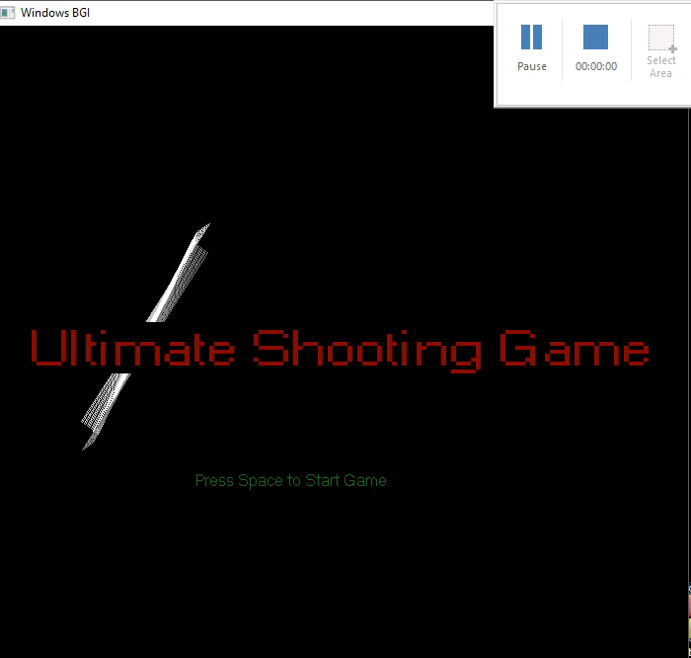

Slide 3
Agenda
Review of key objectives & critical success factors.
How did we do?
Organizational overview
Problems faced by us
Review of and progress against prior goals.
Future goals

Slide 4
Review of Key Objectives & Critical Success Factors
What makes Our game unique?
What makes game successful?

Slide 5
How Did We Do?
At first we try to de every thing with pthread but we haven’t understand anything at all and we also don’t have enough time to plan which thread has to run at what place so we put every thing in a single loop and planned the structure of the whole game, how and when each object has to call etc..
Our game also required basic maths like when a point lies inside a circle this has been used when the bullets hits the target or the obstacles.
We placed everything in a single loop because if we place multiple loops like every function has its own loop then the whole game will be paused and only that object will be moving who call that function till the loop is stopped but now all the objects are updated at almost same time as all the values are updating in a same loop.

Slide 6
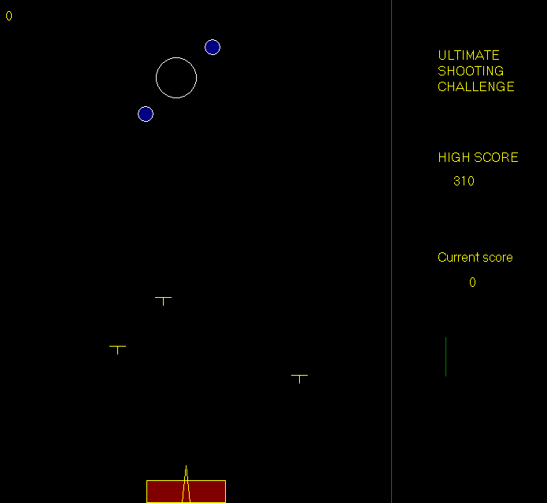
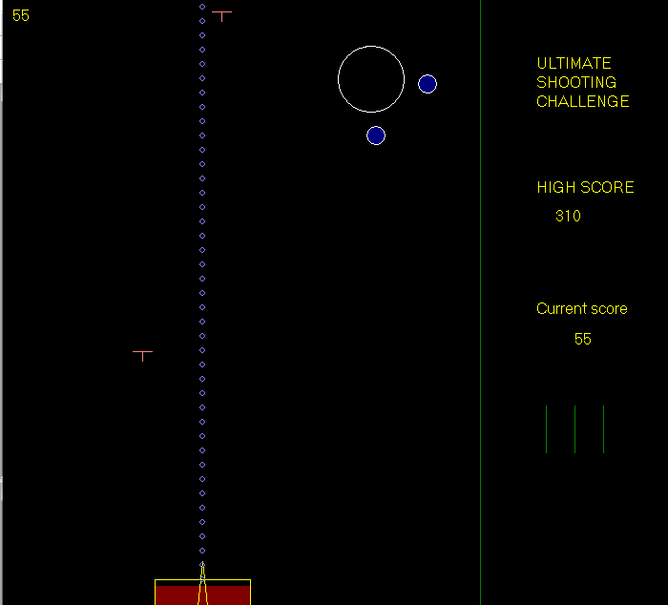
The Game

Slide 7
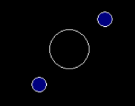
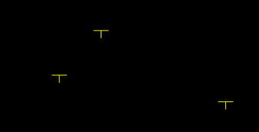
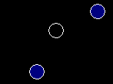
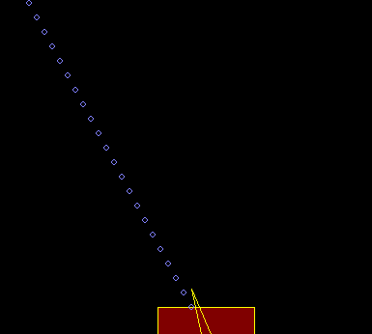
Player has to shoot the Inner circle
And the blue circles are obstacles AND BY dodging bullets
Bullets Target
S shooter

Slide 8
Game level WHEN PLAYER BEATS CERTAIN AMOUNT OF SCORE GAME LEVEL CHANGES AND PLAYER BECOMES FROM BEGINNER TO PRO
Beginner
Pro-player
X(let) health
Y(let) speed of falling objects
2X health
Y+ K speed of falling objects

Slide 9
Overview
player
beginner
pro-player
difficulty increases
Shoots circle
Target circles
Move tank
player physical significance
Falling bullets
Dodge falling objects

Slide 10
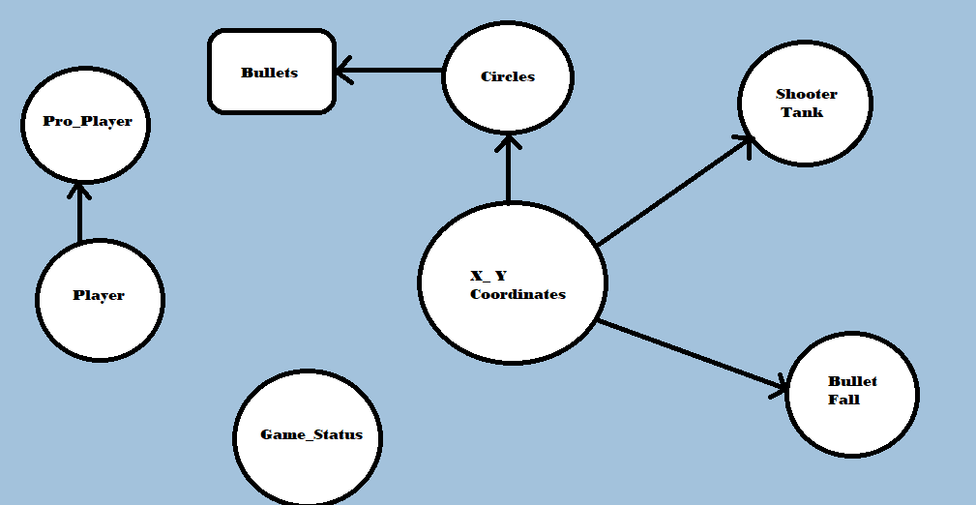
Project Implementation

Slide 11
Basic functions which we have used from graphcs.h
1. outtextxy(x_coordinate,y_coordinate,char* textstring): It silmpy prints the given string to to given coordinates.
2. settextstyle(int font,int direction,int charsize): It decides to font of the string which we like to print.
3. setcolor(color name) : It decide the color of the whatever printing after this function line.
4. circle(x_center_coordinate,y_center_coordinate,radius): make circle at at provided center.
5. line(x1,y1,x2,y2): make line from (x1,y1) to (x2,y2).
6. delay(time(ms)): stop the code execution for that much milli seconds.
7. getch(): saves char in its stream.
8. cleardevice(): clear the whole screen .
9. initwindow(): creates a window on which we work in graphics.

Slide 12

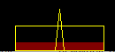
Health bar and shooter
1. This Tank is actually you, you have to move this and protect this.
2. The triangle represents your gun you can rotate it as you like you have to shoot at the circles generating randomly on the screen using this gun.
3. The red bar represents your health.
4. Initially you have 7 health means you can take upto 7 damage from bullets.
5. After getting certain amount of score level will be changed and you health bar will get full and then you can get upto 14 damage from the bullets.
6. As the damage increases your red bar will Starts decreasing.

Slide 13
Randomly generating circles
1. This object will be generated on your screen randomly anywhere you have to shoot the inner bigger circle before it disappears
2. Radius of the inner circle will be decreasing at some rate after which it will disappear and your life will decrease.
3. Those 2 blue circles will be rotating in opposite direction to each other around the inner circle and these two will be an obstacle for you to shoot the inner circle.

Slide 14
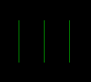
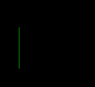
Player’s Life
1. Initially player will have 3 lifes as you as game goes if you are unable to shoot the target circle your life will decrease.
2. If you miss more than 3 circles you will not have any life lift so you will lose.

Slide 15
level change
1. As you break certain amount of score the level will get change speed of bullets falling from about will increase and color of the bullets will change from yellow to red and your health will increase from 7 to 14.
2.Run time polymorphism has been used to change the level of the game.
Initially there is a pointer to a base player class that is pointing to it self as he beats certain amount of score level changes as poiter to player class starts pointing to pro player class.

Slide 16
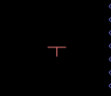
falling objects
1. These Bullets are the real enemy of you in this in this game.
2. If you got hit by them your health will decrease.
3. As the level change speed of their falling will increase
4. At a time, maximum 4 bullets can fall.

Slide 17
The gun
1. The weapon you have in this game is this gun. It shoots circle in range from 0 to 180 degree.
2. You have to shoot the randomly generating target(circles) with this gun.

Slide 18
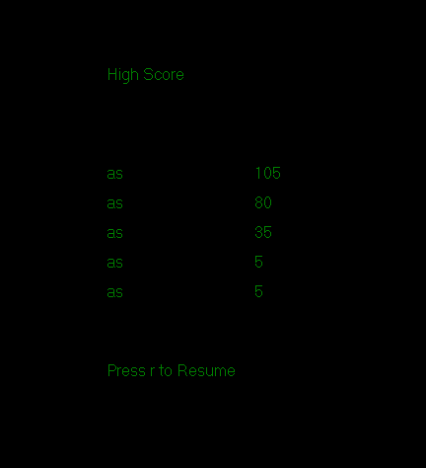
->You can pause the game anytime you want and see ->your previous high score if someone is playing for the first time then file for high score will first be created
->Insertion sort has been used to sort high-score

Slide 19
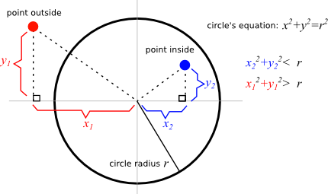
How we are checking if gun has shoot the target
1. Shooter is actually shooting circle whose center coordinates are increasing in straight line.
2. So if distance from center of these shoots circles to the target circle is less than that radius of the target circle than the shooted circle lies inside that of target circle so in other way target has been shoot so in that case destructor of the target circle has been called and score will increase we will see later how score is changing.
3. Same concept has been used when the gun shoots the rotating circle but in this case destructor of the shooting circle has been called because these rotating circles made to be solid shooting circle can’t pass these rotating circles.

Slide 20

how we are checking does the bullets hit the tank or not?
We simply check whether x coordinate of bullet is in range of length of x coordinate of the tank and greater than y coordinate of the top of tank.

Slide 21
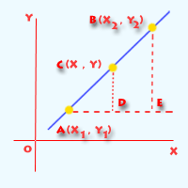
how we are shooting at different angles?
1. In our case y2=y1 and we are only changing x2 with help of postfix ++ and – overloading in shooter class we have discussed earlier.
So by using 2 point form we get a direction for shooting
2. point form:(y-y1)=((y2-y1)/(x2-x1))(x-x1)

Slide 22
Concepts we have implemented from c/c++
Classes and Inheritance
Run time Polymorphism
File Handling
Graphics
Function/Operator Overloading
Macro
enum
Friend Function

Slide 23
Top Issues Faced By Us
How to deal with lagging delays and do our project without parallel programming.
Saving a map to file.
Building a proper structure for the whole game like which class has to be derived from which class.
Introducing Our-self to graphics for the first time.
Whole game is running in a single loop and at each instance screen has been cleared and all the objects has been recreated.
Pressing same key multiple time leads to a large amount of delay in code and game seems to be like it is hanged.

Slide 24
Review of Prior Goals
Optimized and clean code.
Achieved what we have thought to make.
Done our project without use of parallel programming.

Slide 25
Progress Against Goals
Added rotating circles.
Added 2 levels.
Implement what we have studied and Using Object Oriented Programming as mush as possible.
Target to be destroyed when got shot by the gun.
Over come delays.

Slide 26
CURRENT KNOWN BUGS IN OUR GAME
1.if you have pressed a key for a long time like space for a very long time then for some time bullets will keeps
On shooting.
2.if no name is given at the start of the game then high score
Will have no name.

Slide 27
Future Goals
implement this using parallel programming because right know whole game is running in a single loop which makes the game looks flashing.
special object falling, by shooting that object 5 times health and life of the player increases.
better levels.
better score saving method.
Shooting at rotating circles 2 times will let the rotating circles to be destroyed
When bullet is its way radius of circle does’t decrease. We have to fix this too.

Slide 28
Summary
Summarize key successes/challenges
Reiterate key goals
Thanks

